Slide 1



Building
Scalable
Cloud Databases
Presented by:
Tim Lentine
Partner, Director of Development,
CAPS, Inc.
@tlentine

Slide 2

Why This Session?
Building next-generation, cloud-based application to replace traditional client-server app;
Conversation at CodeCamp w/ developers who had no idea multi-shard databases were “easy” with Microsoft tools;
This talk was born of that conversation;

Slide 3


A Few Constraints
Relational Data;
NoSql isn’t a great fit;
Primarily a Microsoft Shop;
Very familiar with SQL Server;
Want ability to keep client data siloed as needed, and ability to scale (out and up) to meet demand;
(Ideally) Don’t really want to worry about things like backups, replication, etc;

Slide 4

So What Are Our Options?
SQL Server
On a VM;
Azure SQL Database;
Database Model
Single Tenant
Multi-Tenant
Data Access:
Roll our own solution
Find something “off the shelf”;

Slide 5

Azure SQL Database
Options
DTU
Database Throughput Unit
A blended measure of CPU, memory, reads & writes
Flexible, changing compute sizes is possible with minimal downtime;
vCore
Gen 5: 1vCore = 1 hyper thread;
More traditional approach: you know how much memory and CPU you are getting;
Elastic Pools
All databases in pool share predefined resources
Great for sporadic uses by given customer;
Managed Instance
Relatively new offering
Great for migrating large numbers of existing SQL Server databases to the cloud;

Slide 6
Elastic Database Tools
(and Sharding)
FTW

Slide 7
Elastic Database Tools
Elastic Database Client Library: enables you to create and maintain sharded databases;
Elastic Database Split-Merge Tool: moves data between sharded databases;
Elastic Database Jobs: enables you to manage large numbers of Azure SQL Databases;
Elastic Database Query: enables you to run Transact-SQL query that spans multiple databases;

Slide 8
Sharding 101
“A Database Shard is a horizontal partition of data in a database or search engine”
–Wikipedia
“Sharding is a technique to distribute large amounts of identically structured data across a number of independent databases”
– Microsoft
https://docs.microsoft.com/en-us/azure/sql-database/sql-database-elastic-scale-introduction#sharding

Slide 9
Sharding: Key Terms
Shard: A database (in a shard set);
Shard Set: The group of Shards (databases) managed by the same Shard Map Manager;
Sharding Key: The column value that determines how data is distributed across shards (think TenantID or CustomerID);
Shard Map: The set of mappings between sharding keys and their respective shards;
Shard Map Manager: A special database that maintains global mapping information about all shards in a shard set;
Shardlets: All of the data associated with a single value of a sharding key on a shard. The smallest unit of data movement possible when redistributing sharded tables;

Slide 10
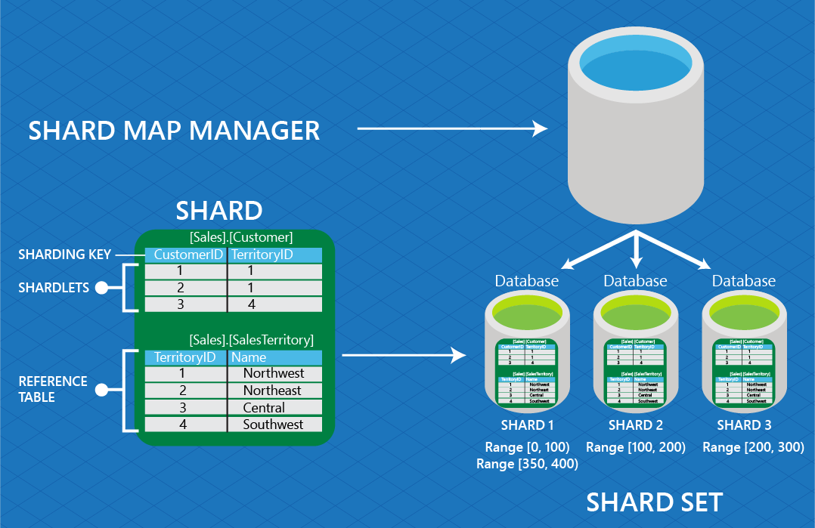
Source: https://docs.microsoft.com/en-us/azure/sql-database/sql-database-elastic-scale-glossary

Slide 11
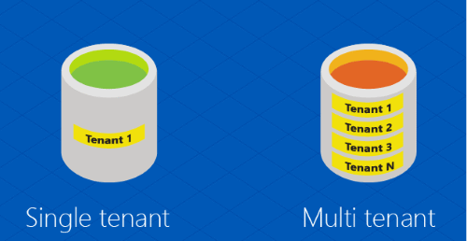
Sharding: Key Terms
Tenant: The end customer;
Single Tenant: One customer \ tenant per database;
Multi-Tenant: Several customers (tenants) packed together in a single database;
Data Dependent Routing: The functionality that enables an application to connect to a shard given a specific sharding key;
Multi-shard query: The ability to issue a query against multiple shards; result sets are returned using UNION ALL; aka “fan-out-query”;

Slide 12
Sharding Keys
Sharding Key: The column value that determines how data is distributed across shards (think TenantID or CustomerID);
Supported Types:
integer
long
guid
byte[]
datetime
timespan
datetimeoffset

Slide 13
Shard Maps
Sharding Map: The set of mappings between sharding keys and their respective shards;
Types of Shard Maps
List-Mapping: e.g. (1,5), (2,3,4), (6,10), (7,8), (9)
Range Mapping e.g. (1-100), (100-200), (200-N)
Which you use depends on your database architecture:
Single Tenant / DB: Use List-Mapping shard map
Multiple Tenants / DB you have a choice:

Slide 14
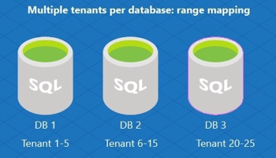
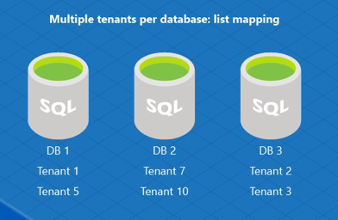
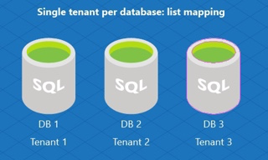
Source: https://docs.microsoft.com/en-us/azure/sql-database/sql-database-elastic-scale-shard-map-management

Slide 15

Where Do I Start?
“Greenfield” or “Brownfield” development?
Consistent usage of database, or sporadic/spiky traffic?
Single tenant per db or multiple tenants per db?
Any regulatory or similar data related concerns?

Slide 16

Opinion-Driven Development
Be careful of the Sharding Key type you use;
Particularly when designing multi-tenant databases;
Example: Guids lead to index fragmentation, can bloat database (16 bytes vs 4 for int);
Put reference \ lookup tables into a separate schema (not dbo);
ref.ZipCode or lkp.State
Be consistent with naming of database objects, including:
Tables, Field Names, and particularly Primary Key fields;
Key fields should be easily recognizable not only to parent table but also the data type;
Id == bad
TenantId == better
ixTenant == best
(i = integer) (x = primary key) (Tenant = parent table)

Slide 17
Elastic Database
Client Library
Client-side tools available for .NET or Java
Nuget: Microsoft.Azure.SqlDatabase.ElasticScale.Client
Library enables:
Ability to manage shards and shard maps;
Data-Dependent Routing;
Querying over multiple shards (multi-shard query);
Adding empty shards;
Cost $: Free!

Slide 18
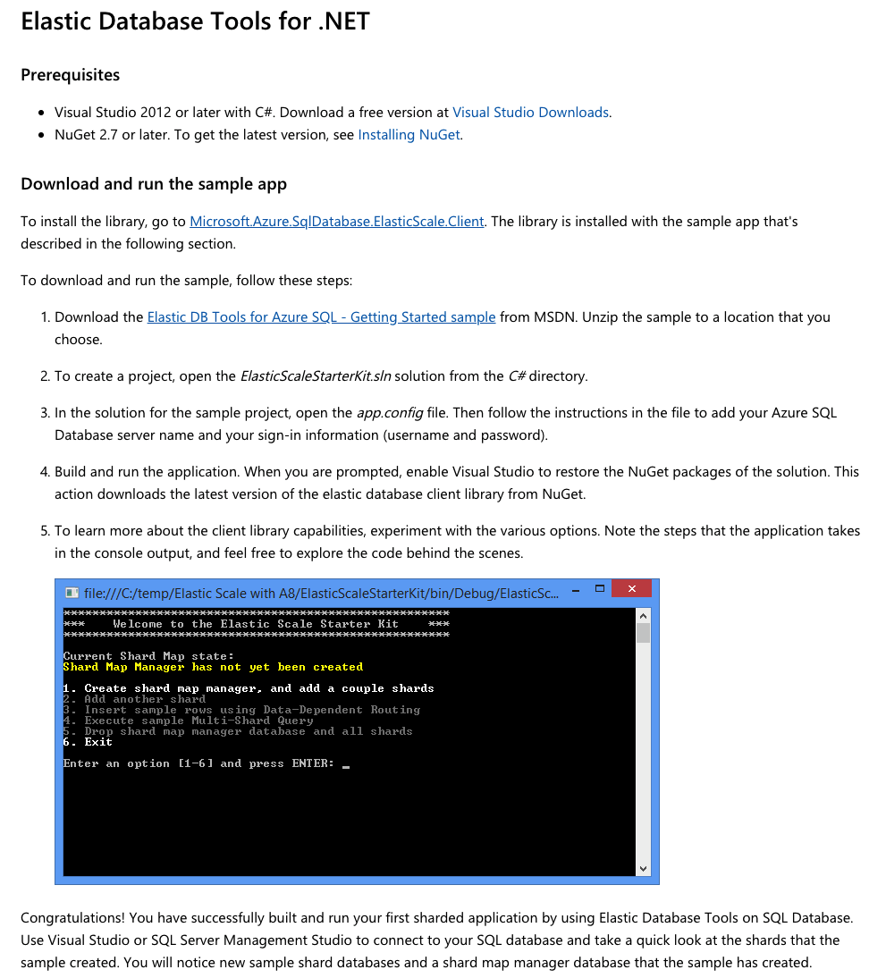
Sample App to Get Started

Slide 19
Client Library
Configuration
Create a new Shard Map Manager;
This is a special database that keeps track of the shards in the shard set;
One time operation to create the Shard Manager;
Add Shard(s) to Shard Map Manager;
Done as new shards are needed;
Define Range or List (PointMapping) to enable Data Dependent Routing (DDR);
Does not necessarily create the database & schema, though you can have EF trigger migrations;
(Optional) Apply SchemaInfoCollection details;
Identifies tables in schema that are either ShardedTableInfo or ReferenceTableInfo;
Necessary if you want to use Split-Merge functionality;

Slide 20

Shard Map Management tips
Keep Shard Management out of your main application;
Favor a dedicated “Management” app instead;
Demo apps from Microsoft don’t do this, but I think they should have a reference app that does : )
Be wary of “Code-First” EF Migrations;

Slide 21
Show Me The Data
Once you have a Shard Map Manager database & Shard(s), your application still needs to connect to the correct shard to retrieve data for any given request;
This is done via Data Dependent Routing (DDR);
At the same time, there may be situations where your app needs to query across all Shards for certain data.
This is accomplished via Multi-Shard Queries;

Slide 22

ShardMapManager
Applications connect to the Shard Map Manager database via a ShardMapManager instance;
The ShardMapManager opens connections to the correct databases when needed, based on the data in the shard map and the value of the ShardingKey;
ShardMapManager should be instantiated once per AppDomain, within the application initialization code;
The ShardMapManager contains caching logic to limit the number of requests that first hit the Shard Map Manager database before routing to the correct shard;

Slide 23
Entity Framework
Data Dependent Routing
Create a special ElasticScaleContext which wraps a DBContext;
Provide an instance of a ShardMap, the ShardingKey & the connection string to the ShardMapManager database to your ElasticScaleContext’s constructor;
Utilize the ShardMap.OpenConnectionForKey method which identifies which shard the key resides in and returns an open DbConnection to that shard (database);
Pass this DbConnection into the base DBContext;
Voila! EF will now query the correct shard for the request;

Slide 24
ADO.NET
Data Dependent Routing
Obtain either a RangeShardMap or ListShardMap from the ShardMapManager;
Use the OpenConnectionForKey method, providing the ShardingKey and ConnectionString to the ShardMapManager database;
The method will return an open SqlConnection to the correct database (shard);
Utilize the SqlConnection to process your SqlCommand;

Slide 25

Entity Framework
&
Multi-Shard Queries
Not Supported
But…
Elastic Client library is Open Source…

Slide 26
ADO.NET
Multi-Shard Queries
Instantiate a special MultiShardConnection providing ConnectionString to Shard Map Manager database and IEnumerable<Shards> to query;
Use this MultiShardConnection as you would a “normal” SqlConnection;

Slide 27

DEMO

Slide 28
Multi-Tenancy
&
Row Level Security
DDR get’s your request to the correct shard, but won’t prevent “Tenant Leakage™️”;
In Single-Tenant designs, this is probably fine;
For Multi-Tenant databases, strongly recommend using Row-Level Security with SQL Server to prevent issues;

Slide 29
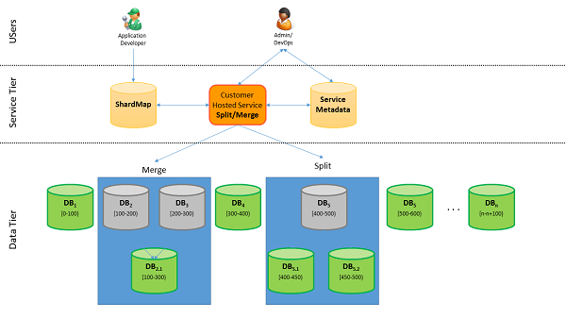
Split-Merge Tool
Allows you to redistribute data between shards as needed;
Runs as an Azure Web Service (Cloud Service with Web & Worker Roles);
Automatically keeps shard map up to date;
Data-Dependent routing connections are killed;
Connections to impacted shardlets are blocked until process completes;
Data-movement performed in batches of shardlets; Once batch is complete shardlets marked as online;
Connections to other shardlets in same shard also killed but will succeed immediately upon retry;
Source: https://docs.microsoft.com/en-us/azure/sql-database/sql-database-elastic-scale-overview-split-and-merge

Slide 30

When would you use
Split-Merge tool?
Need to grow beyond single database;
Need to increase overall capacity to handle explosive growth;
Shrink capacity due to seasonal nature of business;
Manage ‘hotspots’ by moving tenants around;

Slide 31

Elastic Database Jobs
Similar to SQL Agent jobs, but for Azure SQL Database;
Can target any number of Azure SQL Databases / Warehouses in the same Azure cloud as the job agent;
Azure Portal, PowerShell, T-SQL, Azure Resource Manager all supported;

Slide 32

Elastic Jobs Uses
Some Examples:
Deploy new schema objects;
Re-index database;
Collect performance data;
A job’s T-SQL script must be Idempotent;
(If the script succeeds and it is run again, the same results occur)

Slide 33

Elastic Query
(Preview)
Provides ability to run T-SQL queries that span multiple Azure SQL Databases;
Similar to on-premise SQL Server queries that span multiple databases on same server instance OR Linked Servers;
Enables you to connect Microsoft and Third Party tools (e.g. Excel, Power BI, Tableau) to query across data tiers \ databases

Slide 34
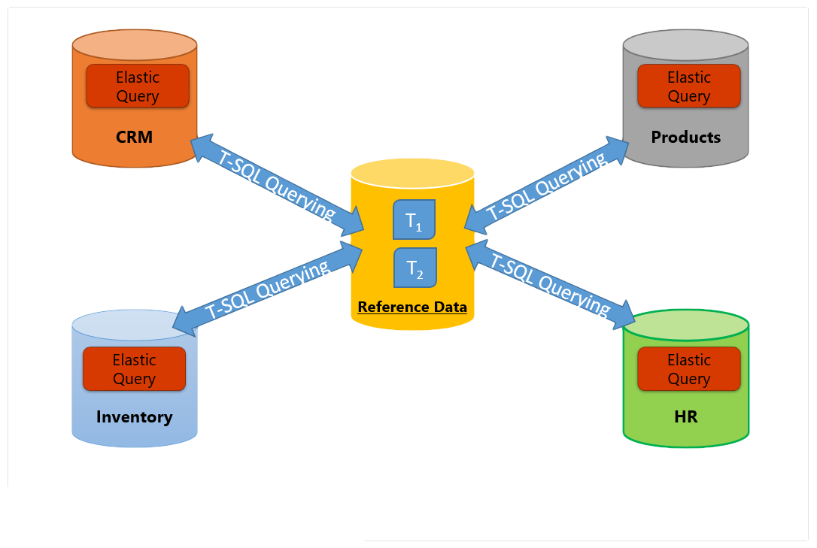
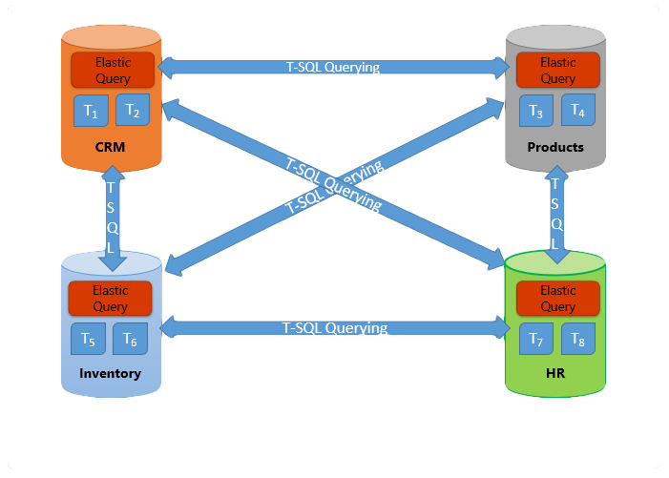
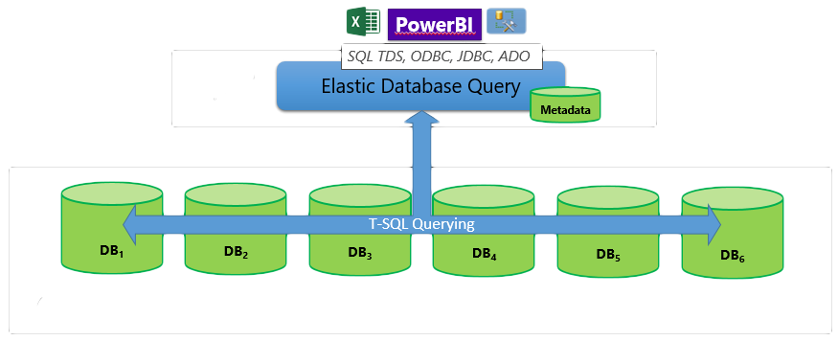
Elastic Query Uses
Query a reference database from other database(s);
Cross-database querying;
Reporting tasks over sharded databases;
Source: https://docs.microsoft.com/en-us/azure/sql-database/sql-database-elastic-query-overview

Slide 35
Brief Recap
Azure SQL Database & Elastic Database Tools are flexible, albeit a little complicated;
Start with small proof of concepts;
Make sure you test your hypotheses around your usage scenarios and requirements;
Keep up to date (as best you can) with changes and new offerings from Microsoft;

Slide 36

Thanks!

